Slide 1



Viviane Martins VBA na Veia facebook.com/VBANaVeia.Oficial
Madrugada Nerdzão Trilha Power BI
Orlando Gomes Microsoft MVP/MSP facebook.com/page.orlandogomes/

Slide 2

Agenda
Conceito de BI;
Power BI;
Principais Elementos;
DAX (Data Analysis Expressions);
Referencias;
Demo.
Notes:
Power BI can unify all of your organization’s data, whether in the cloud or on-premises. Using the Power BI gateways, you can connect SQL Server databases, Analysis Services models, and many other data sources to your same dashboards in Power BI. If you already have reporting portals or applications, you can embed Power BI reports and dashboards into web and app scenarios for a unified experience across any device or platform.

Slide 3



Olá, eu sou o Orlando! =D
Consultor de BI – Lambda3;
Coordenador @Nerdzao;
Formado em Redes de Computadores – FIAP;
Graduando do 4º Ano de Engenharia Mecatrônica - FIAP;
Experiência focada em SharePoint e Power BI;
MSP - Microsoft Student Partner;
Microsoft MVP Data Platform.
Fã de Pokémon / Futebol.
Notes:
Power BI can unify all of your organization’s data, whether in the cloud or on-premises. Using the Power BI gateways, you can connect SQL Server databases, Analysis Services models, and many other data sources to your same dashboards in Power BI. If you already have reporting portals or applications, you can embed Power BI reports and dashboards into web and app scenarios for a unified experience across any device or platform.

Slide 4
Business Intelligence (BI)
“Compreende as estratégias e tecnologias utilizadas pelas empresas para a análise de dados de informações de negócios.
As tecnologias de BI fornecem visões históricas, atuais e preditivas das operações de negócios.”
-Wikpedia
Notes:
Power BI can unify all of your organization’s data, whether in the cloud or on-premises. Using the Power BI gateways, you can connect SQL Server databases, Analysis Services models, and many other data sources to your same dashboards in Power BI. If you already have reporting portals or applications, you can embed Power BI reports and dashboards into web and app scenarios for a unified experience across any device or platform.

Slide 5

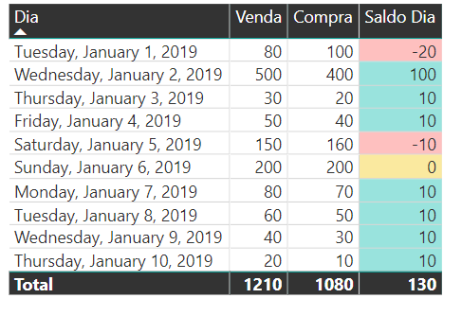
E para que serve ?
Perdeu material!
Perdeu cliente!
Joãozinho
Redução de Perda! (Material/Cliente)
Valor do Negócio!
Joãozinho fez BI de sua padoca! =D
Notes:
Power BI can unify all of your organization’s data, whether in the cloud or on-premises. Using the Power BI gateways, you can connect SQL Server databases, Analysis Services models, and many other data sources to your same dashboards in Power BI. If you already have reporting portals or applications, you can embed Power BI reports and dashboards into web and app scenarios for a unified experience across any device or platform.

Slide 6
O mais importante…
Notes:
Power BI can unify all of your organization’s data, whether in the cloud or on-premises. Using the Power BI gateways, you can connect SQL Server databases, Analysis Services models, and many other data sources to your same dashboards in Power BI. If you already have reporting portals or applications, you can embed Power BI reports and dashboards into web and app scenarios for a unified experience across any device or platform.

Slide 7
BI e um processo e nao uma ferramenta!
Notes:
Power BI can unify all of your organization’s data, whether in the cloud or on-premises. Using the Power BI gateways, you can connect SQL Server databases, Analysis Services models, and many other data sources to your same dashboards in Power BI. If you already have reporting portals or applications, you can embed Power BI reports and dashboards into web and app scenarios for a unified experience across any device or platform.

Slide 8
Power BI
“O Power BI é um conjunto de ferramentas de análise de negócios para analisar dados e compartilhar ideias.
Com um clique, os usuários podem explorar os dados em seu painel usando ferramentas intuitivas que facilitam encontrar as respostas”
-Google
Notes:
Power BI can unify all of your organization’s data, whether in the cloud or on-premises. Using the Power BI gateways, you can connect SQL Server databases, Analysis Services models, and many other data sources to your same dashboards in Power BI. If you already have reporting portals or applications, you can embed Power BI reports and dashboards into web and app scenarios for a unified experience across any device or platform.

Slide 9
Principais Elementos
Services
Desktop
Mobile
Embedded
Web-based
All platforms
Limited design tools
Limited data sources
Dashboards
Publishing
Windows only
Robust design tools
Query and modeling tools
Cross-platform
Report viewers
Report integration
REST services
Create custom visualizations
Notes:
Power BI is a high-level name for Microsoft’s Power BI Services and Tools Suite. In general, all tools draw on the underlying foundation of Power BI Services, which is exposed to users via a web-based design and administration experience. More powerful features are available in the Power BI Desktop application targeting the Windows platform, and mobile versions of Power PI exist for Windows Mobile, iOS, and Android devices that enable end users to interactively access and navigate report and dashboard information. Developer and administrators can also exposed the services of Power BI via Power BI embedded which includes a robust REST-based API as well as tools to create custom visualizations.

Slide 10
Principais Elementos
REPORTS
DATA SOURCES
DASHBOARDS
DEVICES
+
VISUALIZATIONS
Notes:
The basic building block for all Business Intelligence elements in Power BI begins with the data itself. Data from various sources is filtered, cleaned, and combined into Reports via Visualizations, and optionally published to Dashboards. Dashboard data is surfaced to users on any device, based on permissions and organization needs.

Slide 11
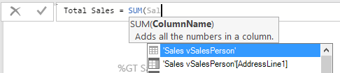
DAX (Data Analysis Expressions)
Coleção de funções, operações e constantes, úteis para calculo de valores e criação de medidas e colunas.
Medidas Calcula um grupo de linhas DEPOIS da agregação.
Colunas Leitura de cada linha ANTES da agregação.
Notes:
Data Analysis Expressions, or “DAX” includes a library of over 200 functions, operators, and constructs and are similar to Excel formulas. DAX has many of the same functions as Excel, except that DAX functions are meant to work over data interactively “sliced” or filtered in a report. If users are familiar with writing Excel functions, its an easy transition into DAX.

Slide 12
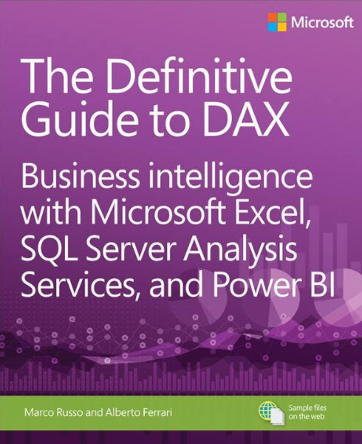
Referencias
Data Stories Gallery;
Aprendizagem Orientada;
Votação de Recursos;
Livro: The Definitive Guide to DAX.
Notes:
The basic building block for all Business Intelligence elements in Power BI begins with the data itself. Data from various sources is filtered, cleaned, and combined into Reports via Visualizations, and optionally published to Dashboards. Dashboard data is surfaced to users on any device, based on permissions and organization needs.

Slide 13
WorkShop – Explorando o Power BI
Notes:
The basic building block for all Business Intelligence elements in Power BI begins with the data itself. Data from various sources is filtered, cleaned, and combined into Reports via Visualizations, and optionally published to Dashboards. Dashboard data is surfaced to users on any device, based on permissions and organization needs.

Slide 14
Projeto no Github
https://github.com/orlandogomes/madrugada-pbi
Notes:
The basic building block for all Business Intelligence elements in Power BI begins with the data itself. Data from various sources is filtered, cleaned, and combined into Reports via Visualizations, and optionally published to Dashboards. Dashboard data is surfaced to users on any device, based on permissions and organization needs.

Slide 15
Poke Projeto
http://bit.ly/pbi-pokemon
Notes:
The basic building block for all Business Intelligence elements in Power BI begins with the data itself. Data from various sources is filtered, cleaned, and combined into Reports via Visualizations, and optionally published to Dashboards. Dashboard data is surfaced to users on any device, based on permissions and organization needs.

Slide 16
Painel MVP BR
http://bit.ly/pbi-mvp
Notes:
The basic building block for all Business Intelligence elements in Power BI begins with the data itself. Data from various sources is filtered, cleaned, and combined into Reports via Visualizations, and optionally published to Dashboards. Dashboard data is surfaced to users on any device, based on permissions and organization needs.

Slide 17
Consumo NodeRed
http://bit.ly/pbi-nodered
Notes:
The basic building block for all Business Intelligence elements in Power BI begins with the data itself. Data from various sources is filtered, cleaned, and combined into Reports via Visualizations, and optionally published to Dashboards. Dashboard data is surfaced to users on any device, based on permissions and organization needs.

Slide 18
Consumo NodeJS
http://bit.ly/pbi-crush
Notes:
The basic building block for all Business Intelligence elements in Power BI begins with the data itself. Data from various sources is filtered, cleaned, and combined into Reports via Visualizations, and optionally published to Dashboards. Dashboard data is surfaced to users on any device, based on permissions and organization needs.

Slide 19
Consumo Facebook API
http://bit.ly/pbi-face
Notes:
The basic building block for all Business Intelligence elements in Power BI begins with the data itself. Data from various sources is filtered, cleaned, and combined into Reports via Visualizations, and optionally published to Dashboards. Dashboard data is surfaced to users on any device, based on permissions and organization needs.

Slide 20




Contatos
medium.com/@_orlandogomes
linkedin.com/in/orlandomariano
facebook.com/page.orlandomaiuri
orlando.mariano@studentpartner.com
Notes:
The basic building block for all Business Intelligence elements in Power BI begins with the data itself. Data from various sources is filtered, cleaned, and combined into Reports via Visualizations, and optionally published to Dashboards. Dashboard data is surfaced to users on any device, based on permissions and organization needs.

Slide 21
Obrigado =D
Notes:
The basic building block for all Business Intelligence elements in Power BI begins with the data itself. Data from various sources is filtered, cleaned, and combined into Reports via Visualizations, and optionally published to Dashboards. Dashboard data is surfaced to users on any device, based on permissions and organization needs.

